Slide 1
Chapter 1: Dot NET 101

Slide 2
Learning Objectives
Introduction to compilers and code generation.
Platform independent development technologies and intermediate instruction/code.
History and background of .Net.

Slide 3
C# Compiler: Introduction
C# programs run on the .NET Framework, an integral component of Windows that includes a virtual execution system called the common language runtime (CLR) and a unified set of class libraries. The CLR is the commercial implementation by Microsoft of the common language infrastructure (CLI).
Source code written in C# is compiled into an intermediate language (IL) that conforms to the CLI specification. The IL code and resources, such as bitmaps and strings, are stored on disk in an executable file called an assembly, typically with an extension of .exe or .dll. An assembly contains a manifest that provides information about the assembly's types, version, culture, and security requirements.
Language interoperability is a key feature of the .NET Framework. Because the IL code produced by the C# compiler conforms to the Common Type Specification (CTS), IL code generated from C# can interact with code that was generated from the .NET versions of Visual Basic, Visual C++, or any of more than 20 other CTS-compliant languages.
In addition to the run time services, the .NET Framework also includes an extensive library of over 4000 classes organized into namespaces that provide a wide variety of useful functionality for everything from file input and output to string manipulation to XML parsing, to Windows Forms controls. The typical C# application uses the .NET Framework class library extensively to handle common "plumbing" chores.

Slide 4
C# Code Compilation & Execution Process
C# source files along with references and resources (bitmaps, strings etc.) are fed into C# compiler.
C# Compiler (csc.exe) generates MSIL (intermediate language) code as an assembly.
The assembly is loaded into the CLR, which might take various actions based on the information in the manifest. Then, if the security requirements are met, the CLR performs just in time (JIT) compilation to convert the IL code to native machine instructions.
The CLR also provides other services related to automatic garbage collection, exception handling, and resource management. Code that is executed by the CLR is referred to as "managed code”.

Slide 5
Platform Independence
Dot NET is a cross platform software development technology.
A cross platform development technology is a software development environment that can be used to create software that can run across:
Multiple processor architectures (e.g. X86/X64 or ARM) or
Multiple Operating Systems Or
Even providing support for multiple programming languages can be considered as cross platform.
Some of the famous languages and tools apart from Dot NET, for cross platform development technologies are:
Java
Node.Js
Python
PhoneGap (Mobile)
Sencha (Mobile)

Slide 6
Benefits of Intermediate Code
If a compiler translates the source language to its target machine language without having the option for generating intermediate code, then for each new machine, a full native compiler is required.
Intermediate code eliminates the need of a new full compiler for every unique machine by keeping the analysis portion same for all the compilers.
The second part of compiler, synthesis, is changed according to the target machine. This is known as Just in Time compilation.
It becomes easier to apply the source code modifications to improve code performance by applying code optimization techniques on the intermediate code.

Slide 7
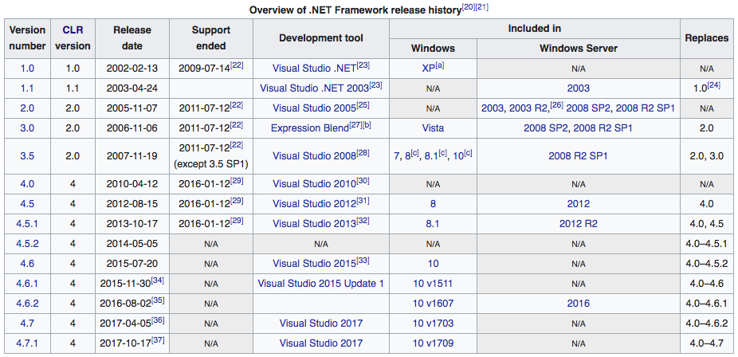
History of Dot NET Framework

Slide 8
Example: MSIL Code Example
See DNPE-Chapter1 (MSIL.cs) at https://github.com/DotNetTraining/DotNetEssentials/tree/master/Code/DNPE/DNPE-Chapter1

Slide 9
What are we learning in Next Chapter ?
You will learn about Dot Net Architecture.
We will learn about:
.Net Philosophy: CLS, CTS, CLR and MSIL (CIL).
Types in CIL (Value Types V/S Reference Types)
Programming Languages and Platforms supported by .Net.
Assemblies and App Domains

Slide 10
Thank You !

